Slide 1
Keyboard & Basic Audio
TMA Training Center (TTC)
Course | iPhone application development
Trainer | Thuong Tran
Designed by | TMA Mobile Solutions (TMS)
Last updated | 25 Mar 2011

Slide 2
This section objectives
Understanding about Keyboard and Basic Audio in iPhone Development

Slide 3
Content
Keyboard
Keyboard Demo
Basic Audio
Project assignment: implementation

Slide 4
Keyboard

Slide 5
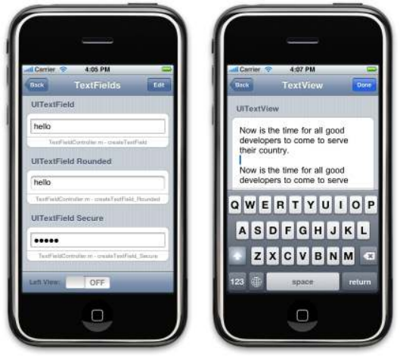
Keyboard and Text input
•The text system was design to be simple and kept mobile user’s needs in mind
•TextField for single line editing while UITextView for multiple lines editing
• Keyboard and text handle Unicode and single/multi-line input
•When you click on a text box the
keyboard appears
• Can be portrait and landscape
• Keeping the finger on the screen enables magnification

Slide 6
Text Input Delegates
As with other iPhone components you need to provide a delegate object for managing events and providing custom behavior
Text Views send several notifications to the delegate (e.g. great for validation):
  Editing began (e.g. UITextFieldTextDidBeganEditingNotification for field)
  Editing ended (e.g. UITextFieldTextDidEndEditingNotification for field)
To define a delegate that supports a UITextView:
  It needs to implement UITextViewDelegate
To define a delegate that supports a UITextField:
  It needs to implement UITextFieldDelegate

Slide 7
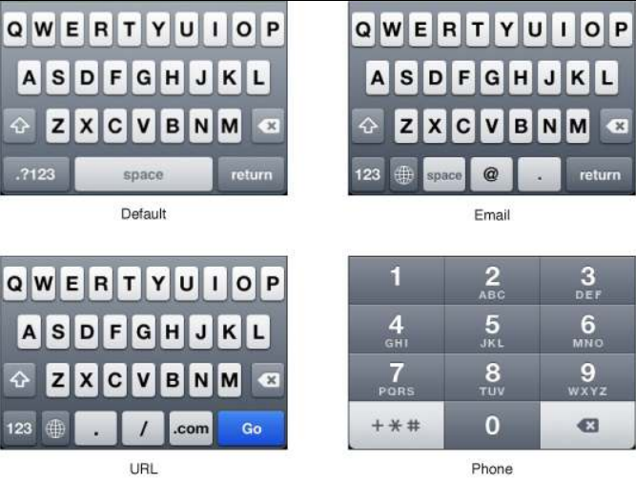
Different Keyboards

Slide 8
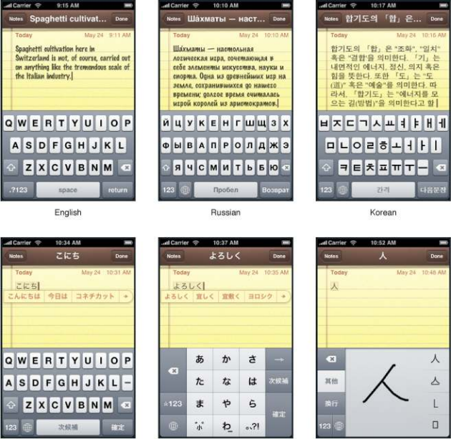
Keyboard Languages

Slide 9
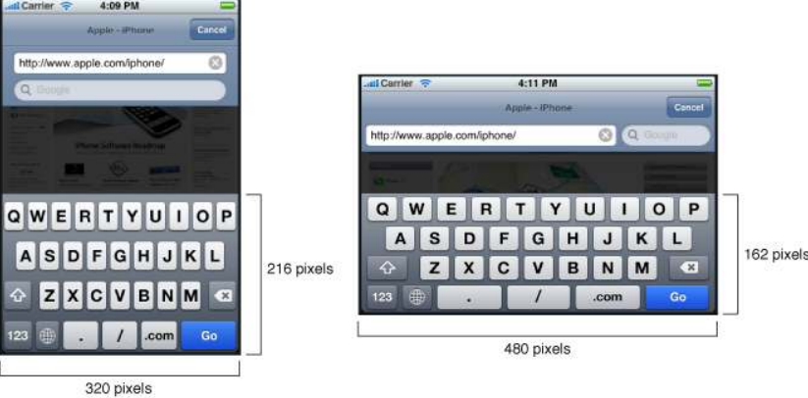
Keyboard Landscape/Portrait

Slide 10
Keyboard Notifications
The iPhone OS dispatches the following keyboard notifications:
  UIKeyboardWillShowNotification
  UIKeyboardDidShowNotification
  UIKeyboardWillHideNotification
  UIKeyboardDidHideNotification

Slide 11
Keyboard and Text Input Demo

Slide 12
Exercise
Create a text view and a character counter for it.
Make maximum characters are 20 (means when user type more than 20 characters, don’t show more. User can tap “backspace”)

Slide 13
Basic Audio

Slide 14
Uses for Audio
Make iPhone use fun! Have user feedback via sound effects
  alert sounds on notification/error
  button clicks
  background music
  association with other user actions…
Possible to have any length of sounds such as music or wave files
Can stream and record as well

Slide 15
Core Audio
Core Audio is Apple’s high‐level audio framework
  Used both on the iPhone & Mac but iPhone version more compact
Different APIs for sound:
  System Sound API (Popular)
    short sounds and very basic
  AVAudioPlayer/AVAudioRecorder
    can play longer sounds and more powerful
  Audio Toolbox
    streaming, much more powerful
  Audio Units
    for professional sounds and processing
  OpenAL: for three dimensional spatial sound for use in games

Slide 16
System Sound API
For short sounds the System Sound API is the way to go
  Short sounds on the iPhone means 5 seconds or less
  If longer the sound won’t play or other strange issues
The simplest sound API but has numerous restrictions
  there is no volume control
  no looping
  the sound is played back right away even if another sound is playing
    the other sound is cut off
  limited file formats (*.wav, *.caf, *.aif,…)

Slide 17
Playing Short Sounds
It’s important to clean up after you are done playing the sound
  In order to do this you need to dispose the sound ID
  If you get a memory warning you can dispose then as well
AudioServicesDisposeSystemSoundID (mySoundId);

Slide 18
Vibration
Through the System Sound API you can vibrate instead of playing a sound
In order to do this you need to use a special system sound ID
kSystemSoundID_Vibrate
There is no vibration on iPod Touches!
‐ (void)triggerVibrate {
// trigger vibration ie. to an alert
  AudioServicesPlaySystemSound (kSystemSoundID_Vibrate);
}

Slide 19
AVAudioPlayer
AVAudioPlayer’s main use is to play long sounds (> 5 seconds)
  looping available
  can seek, pause
  can play multiple sounds at the same time
  API is Objective C
  supports numerous formats

Slide 20
AVAudioPlayer
As before you will need to create a file URL and use AVAudioPlayer object:
AVAudioPlayer *myPlayer;
NSString *soundPath = [[NSBundle mainBundle] pathForResource...];
NSURL *fileUrl = [NSURL fileURLWithPath:soundPath];
myPlayer = [[AVAudioPlayer alloc] initWithContentsOfURL: fileUrl];
if (!myPlayer.playing) {
[myPlayer play];
} else {
[myPlayer pause];
}

Slide 21
AVAudioPlayerDelegate
The delegate is alerted when:
  playback finishes
  audio decode errors (as opposed to encode)
  hooks for handling interruptions
    e.g. iPhone is phone first

Slide 22
Basic Audio Demo

